Slide 1

Stage 7/Bay 6 No Individual Walkthroughs Course Designer: IDPA, kinda
No Individual Walkthroughs is a 24 round, 120 point Comstock medium course. There are 12 USPSA targets. The best 2 hits per target will score. The start signal is audible.
The Handgun start position is inside the box with wrists above shoulders. Handgun is loaded and holstered. PCC starting position inside the box. PCC loaded, safety on, stock touching belt.
On the audible start signal, engage all targets from within the shooting areas.

Slide 2
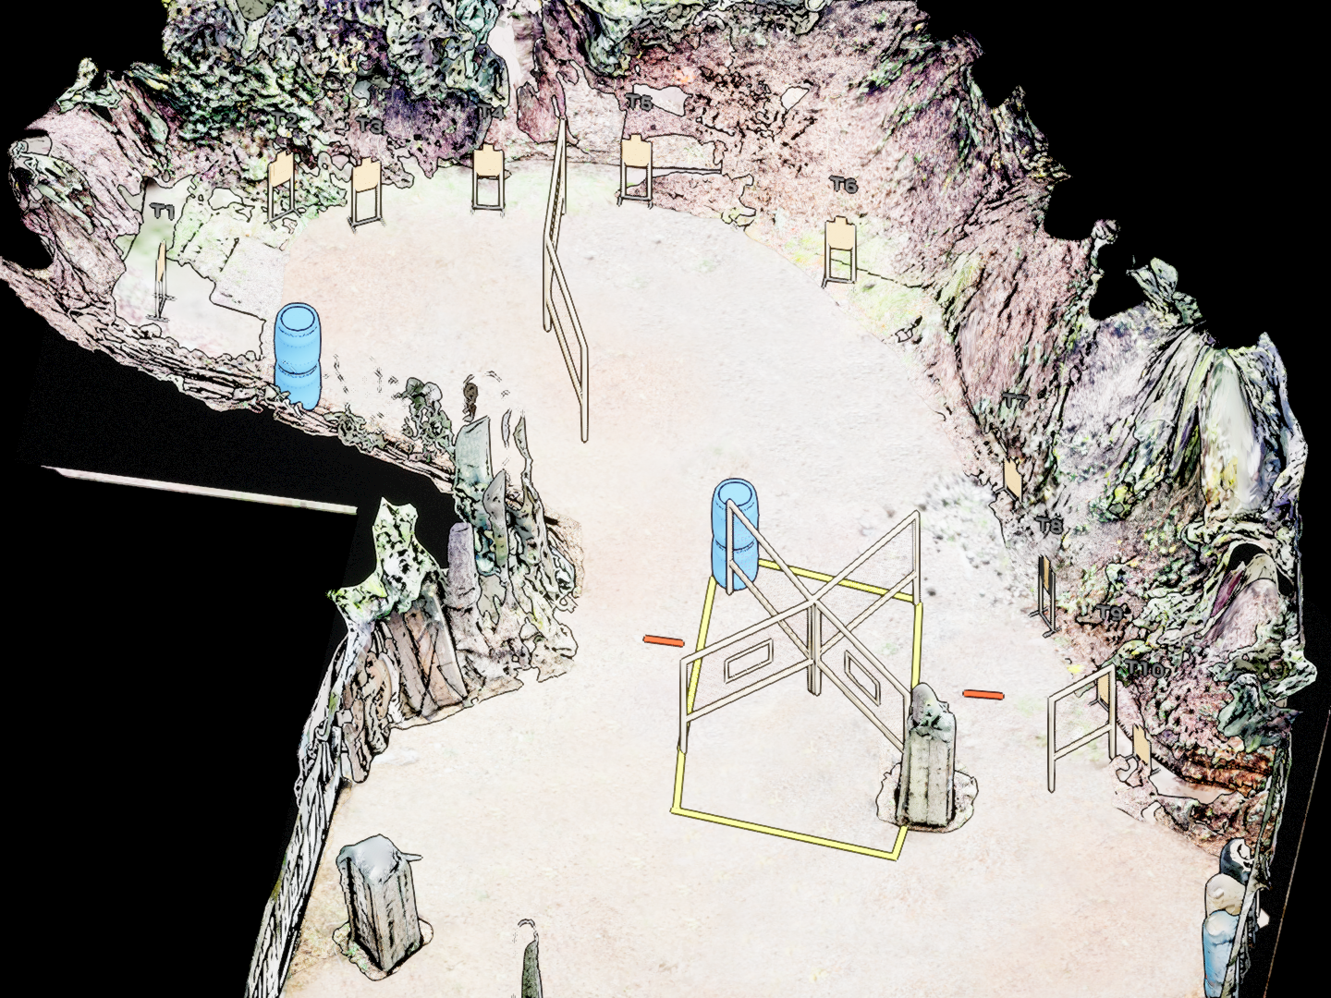
 | Stage 8/Bay 7 X Factor Course Designer: Eric Beerbaum

